Slide 1
More on Python
Day 8
The Data Boot Camp |
November 27, 2018

Slide 2
Refresher

Slide 3
For Loop
Python
loop through a range of numbers (0-4)
loop executes 4 times**
for x in range(5):
print(x)
loop through a range of numbers (2-4)
loop executes 3 times**
for x in range(2, 5):
print(x)
zoo = ["cow", "dog", "bee"]
for animal in zoo:
print(animal)
** up to 5 (upper bound) but no
including 5
VBA
loop through a range of numbers (0-5)
loop executes 6 times
For x = 0 to 5
MsgBox(x)
loop through a range of numbers (2-5)
loop executes 3 times
For x = 2 to 5
MsgBox(x)
For each worksheet in worksheets

Slide 4
More on For loop…
Custom interval
for x in range(0,10,2):
print(x)
Ouptut:
0
2
4
6
8
print x in increment of 2 up to 10 but exclude 10

Slide 5
More on For loop…
Custom interval processing backward
for x in range(0,10,-2):
print(x)
Ouptut:
10
8
6
4
2
print x in decrement of 2 start with 10 to 0 exclude 0

Slide 6
While loop
while loops will run blocks of code just like a for loop does but will continue looping for as long as a condition is met
run = "y"
while run == "y":
print("Hi!")
run = input("Enter ‘y’ to continue, ‘s’ to stop: ")

Slide 7
Let’s Start Coding

Slide 8
Student Activity
kid_in_candy_store.py
items (variables) in my program – identify nouns:
# a list of candies to print to the screen
candyList = ["Snickers", "Kit Kat", "Sour Patch Kids",
"Juicy Fruit", "Swedish Fish", "Skittles",
"Hershey Bar", "Skittles", "Starbursts", "M&Ms"]
# the max amount of candy that can be selected by the user
allowance = 5
# a shopping cart contain a list of candies selected
candyCart = [ ]

Slide 9
Student Activity cont’d
kid_in_candy_store.py
pseudo code (actions in my program) – identify verbs:
create a for loop to print the the items in the candyList
create a for loop that will:
capture users input/selection up to 5 candies (max allowance)
add items to the candyCart
create a for loop that prints items in candyCart (the list of candies selected by the user)
Bonus: create while loop that will allow user to make selection until some condition is met: input is “no”

Slide 10
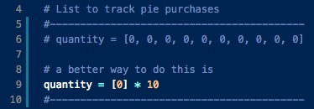
Student Activity
house_of_pie.py
items (variables) in my program:
# list of available pies for purchased
# shoping cart
# status to track shoping status (condition/flag to stop loop)
bonus section of exercise:

Slide 11
Student Actiivity cont’d
house_of_pie.py
pseudo code (actions in my program):
# print wecome message
# while continue shopping is “yes” do
# display list of pies to be selected from
# capture user preference
# add selection to shopping cart (remember to use index-1)
# display message that pie is in stock
# ask user if they want to continue shopping and capture response
# display the total quantity in shopping cart
Bonus: create while loop allow user to make selection until some condition is met: input is “no”

Slide 12
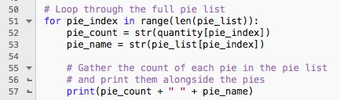
Review house_of_pie_bonus.py
Both arrays contain equal numbers of elements (10)
quantity = [0, 3, 0, 0, 2, 0, 0, 0, 0, 0]
pie_list = ["Pecan", "Apple Crisp", "Bean", "Banoffee",
"Black Bun", "Blueberry", "Buko", "Burek", "Tamale", "Steak"]
We can use the same index to reference the direct correlation between two arrays

Slide 13
Reading File

Slide 14
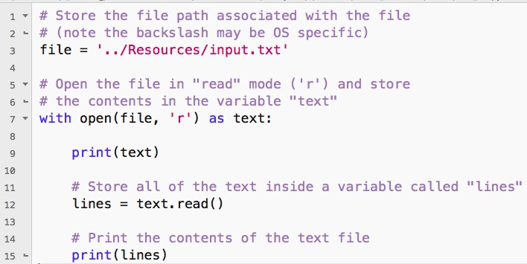
with key word and local variables

Slide 15
with key word and local variables cont’d
the with statement simply means the scope of text variable is only applicable within this block of code. It will be removed from memory and not recognized outsides of this block of code.
code within the with block is not a loop
file is not read line by line but a dump of the file to a variable and print it
file is open in read-only mode (can read but not write to file)
open ( file , ‘r’ )

Slide 16
Modules

Slide 17
Class Activity- Review Module
Modules are built-in codes from Python standard library
Common modules are:
date
datetime
file
os
os.path
random
https://docs.python.org/3/library/index.html

Slide 18
Reading .csv File

Slide 19
CSV Reader vs. Plain File Reader
must import file module
regular file reader returns each line as string:
each line is a string of text
must to import csv module
csv file reader returns each line as a list:
Header can be printed separately
each row is a list data in colums

Slide 20

Class Activity - netflix.py Review
Imports both the `os` and `csv` modules for use later on. It is common practice to import all modules at the start of an application.
When opening up the CSV file, the code dictates that each new line in the file should be viewed as a new line of data to be read in.
When reading the CSV file, the delimiter is set to `","` to ensure Python splits up the data into the proper columns whenever a comma is found.

Slide 21
CSV Reader / Writer
reader
import os, csv
with open … as statement
…(path, 'r', newline='')
csv.reader(file, delimiter=',’)
writer
import os, csv
with open … as statement
…(path, 'w', newline='')
csv.reader(file, delimiter=',’)
csvwriter.writerow(
[‘col1’, ‘col2’, …] )

Slide 22
Questions / Discussion
Notes:
It’s important to keep in mind why you joined this class. Let’s talk about your goals.

